Slide 1
Dashboard Design in Power BI

Slide 2
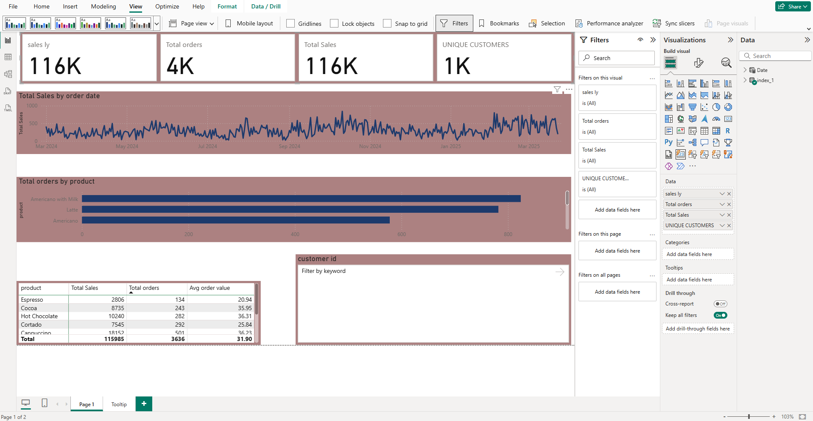

Slide 3
Key facts
1. Dataset
Coffee shop sales data.
Columns: Order Date, Payment Type, Customer ID, Product, Amount.
2. Data Preparation
Cleaned missing values (Power Query).
Built a Date Table with CALENDAR function.
Created measures:Total Sales = SUM(Amount)Total Orders = COUNTROWS(Table)Unique Customers = DISTINCTCOUNT(CustomerID)Avg Order Value = DIVIDE([Total Sales], [Total Orders])Sales Growth % = ([This Year Sales] - [Last Year Sales]) / [Last Year Sales].
3. Dashboard Layout
Top (KPI Cards): Total Sales, Total Orders, Avg Order Value, Unique Customers, Sales Growth %.
Middle:Line chart → Sales trend by Month.Bar chart → Sales by Product.Donut chart → Payment type (Cash vs Card).
Bottom: Table → Product performance (Sales, Orders, Avg Order Value).
4. Interactivity
Slicers → Date, Product Category, Payment Type.
5. StylingApplied
consistent theme (coffee-style brown/cream).
Formatted visuals with uniform fonts, borders, and colors.
Removed scrollbars by resizing visuals.

